Slide 1
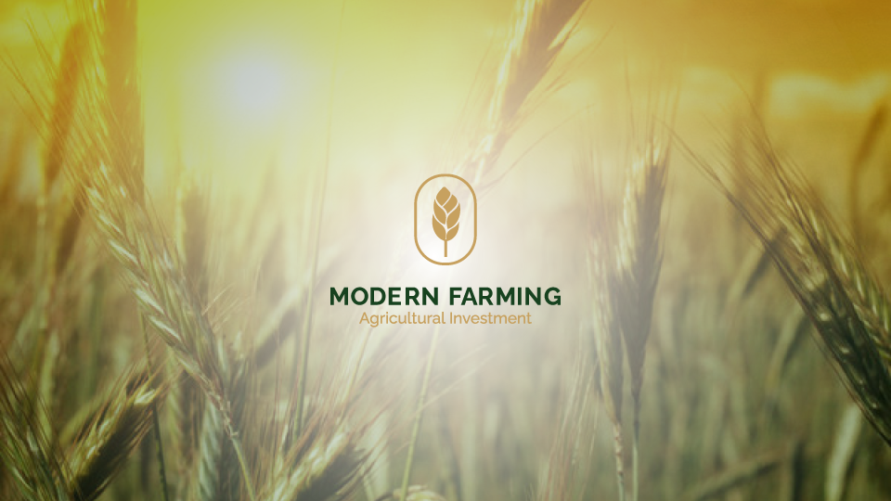

Slide 2

in the year 2050 Agricultural producers will face a great challenge, which is the need to increase food production by 60% with limited agricultural land and water. Here comes the role of advanced technology to raise efficiency and increase productivity. As a result, the company has started reclaiming 3,000 acres in 2017 using the latest agricultural systems, including precision farming systems.

Slide 3
Modern Farming agriculture investment is specialized in farming and cultivation of crops like wheat, corn, potatoes, soybean, sunflower, sugar beets, strawberries and forage. All of which are produced by using the latest agricultural techniques, from seeds to advanced irrigation systems and efficient well-trained labor.
We import high quality seeds and use the latest agricultural machinery to raise the standards of efficiency and productivity, and most importantly, to contribute to environmental protection. We embrace “Zero Waste” policy, where wastes get recycled and transformed into biomass.
Further, we make sure that we comply with highest standards of environmental sustainability and use the latest most secure technological methods in our business.
We are also proud to do our share to the community by sharing in Decent Life Sustainable rural communities ( Hayah Karima).

Slide 4
, Main Objectives
Education and Training institute.
Agriculture Laboratory
Agriculture Equipment
Seeds

Slide 5
Education and Training institute
Establishing an education and training institute to provide the necessary trained personnel for the project’s agricultural sectors.

Slide 6
Agriculture Laboratory
Partnering with an American company specialized in managing and operating laboratories specialized in analyzing soil, plants, water, fertilizers, forage and pesticide residues and purchasing the necessary equipment for this.

Slide 7
Agriculture Equipment
Partnering with an American company specialized in managing, operating and maintaining agriculture equipment, and purchasing the latest equipment compatible with precision farming.

Slide 8
Seeds
Looking for purchasing High quality Corn, soyabean, sunflower, sugar beet, cotton, canola, forage and potatoes Seeds.

Slide 9
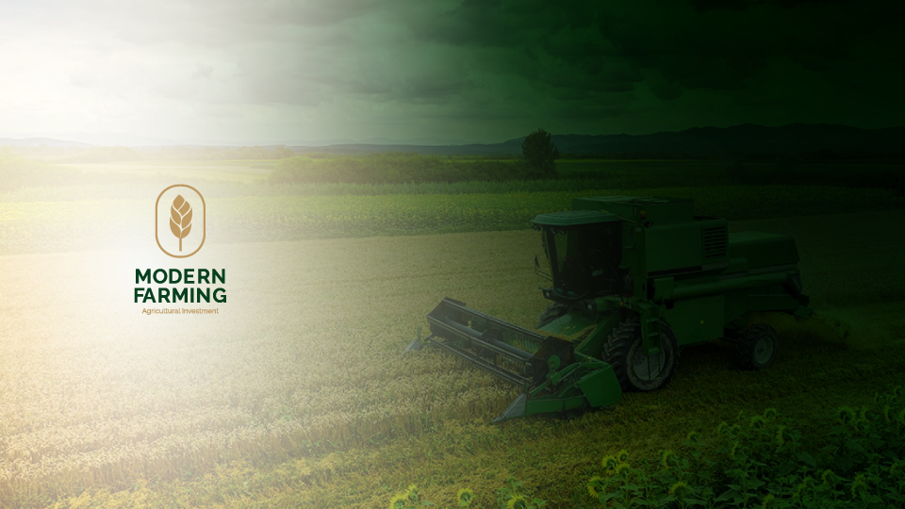
Thank You for your time

